Slide 1
Eco way finder
Logesh S 2021503519
Varun D 2021503567
Santhosh D 2021503047

Slide 2

Problem Statement:
Air pollution in urban environments poses a significant threat to public health and the environment. Commuters are exposed to varying levels of air pollutants during their daily travels, impacting their well-being. There is a critical need for a solution that leverages technology to optimize commuting routes, ensuring users can navigate through urban areas while minimizing their exposure to poor air quality. The existing lack of a comprehensive system integrating real-time air quality data with route optimization hinders individuals from making informed and health-conscious decisions during their daily commutes.

Slide 3

Objectives:
Real-Time Air Quality Integration:
Develop a system that integrates real-time air quality data into route planning algorithms, enabling users to choose paths that minimize exposure to high levels of air pollutants.
Health-Conscious Commuting:
Facilitate health-conscious commuting by providing users with optimized routes that prioritize air quality, ultimately reducing the risk of health issues associated with air pollution.
Environmental Impact Awareness:
Increase public awareness of the environmental impact of commuting choices by providing information on carbon footprint reduction and encouraging eco-friendly transportation practices.

Slide 4
Objectives:
Urban Planning Integration:
Collaborate with urban planners to integrate environmental policies into the route optimization process, contributing to more efficient urban planning and resource management.
User-Friendly Interface:
Develop an intuitive and user-friendly interface accessible through mobile applications, making it easy for users to input destinations, receive route recommendations, and access real-time air quality information.

Slide 5
Expected Outcomes:
A functional Eco way finder application accessible through web and mobile platforms.
Improved user decision-making regarding commuting routes, considering both travel efficiency and air quality.
Reduction in individual exposure to high levels of air pollution during daily commutes.
Increased public awareness and engagement in sustainable transportation practices.
Enhanced overall urban air quality by promoting eco-friendly commuting choices.

Slide 6
Target Audience:
The EcoWayfinder project aims to benefit commuters, urban planners, and environmental enthusiasts who seek to make informed and environmentally conscious choices while navigating through urban areas. By providing real-time data and optimized routes, the application targets individuals who prioritize their health and wish to contribute to the overall improvement of urban air quality.

Slide 7

Technologies used:
Javascript
Mysql
Nodejs
React
HTML
CSS
Python
Mapbox API

Slide 8
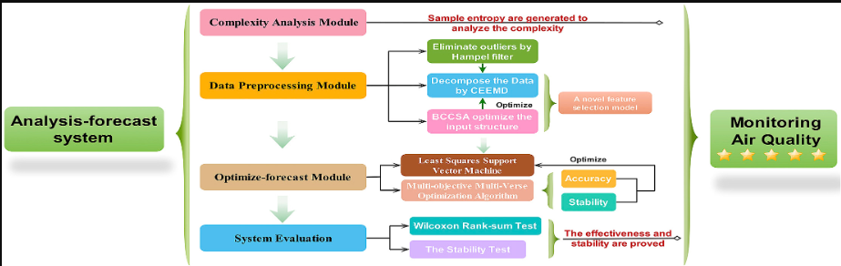
Implementation:

Slide 9

Implementation:

Slide 10

Implementation:

Slide 11
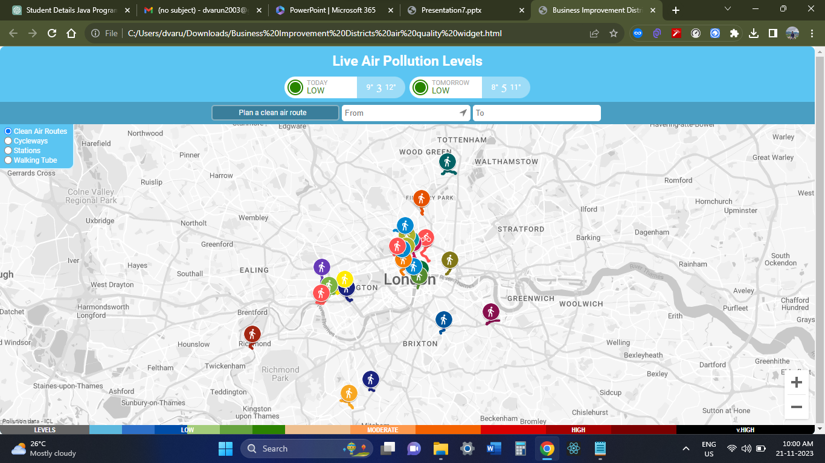
Main page:

Slide 12
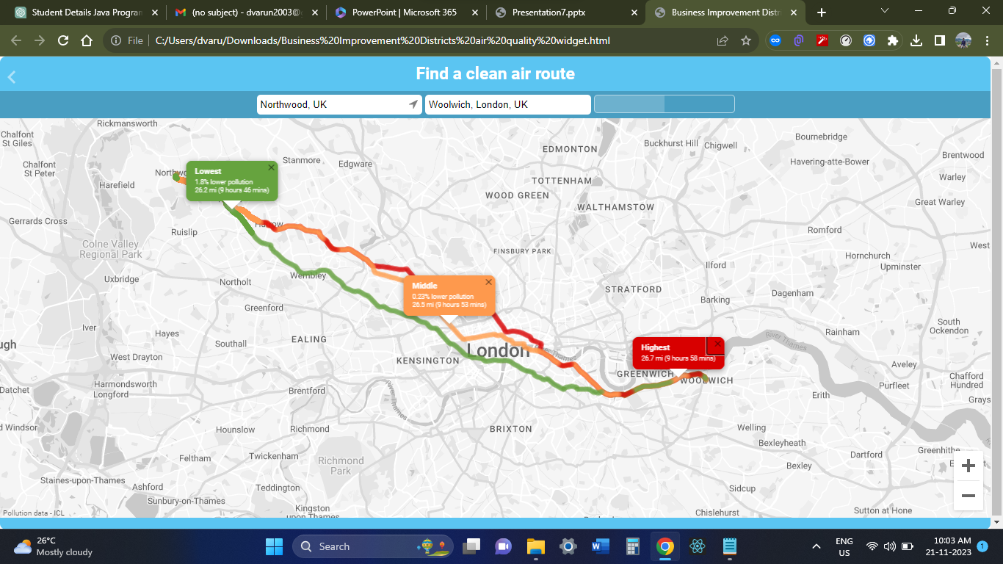

Slide 13

Thank you!

